Slide 1
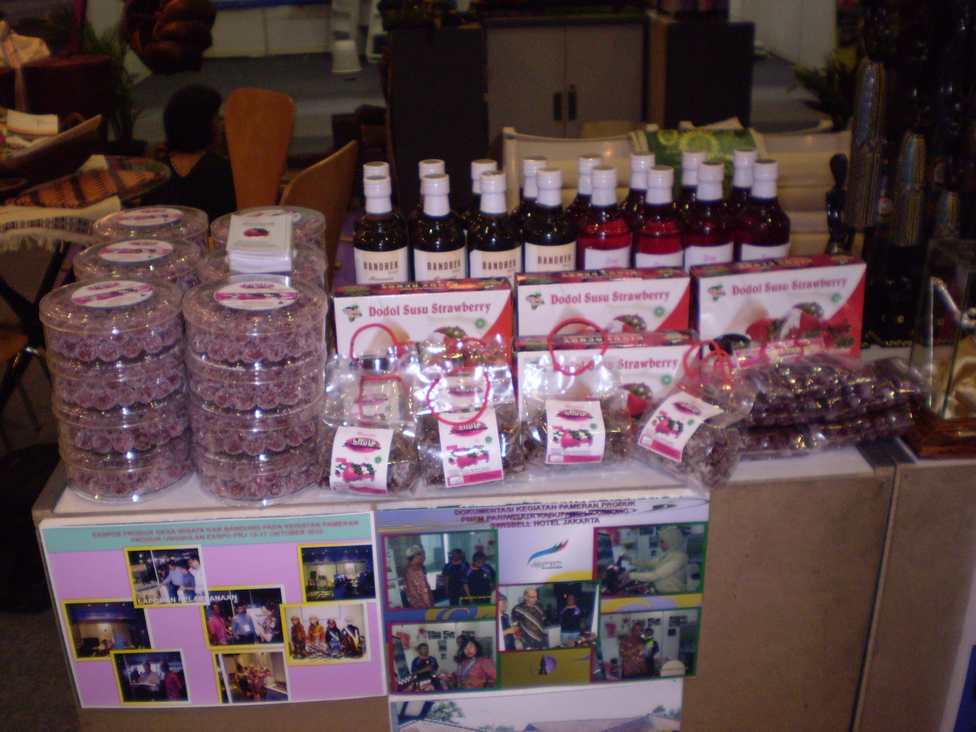

Slide 2
Olahan strawberry kiny berry

Slide 3
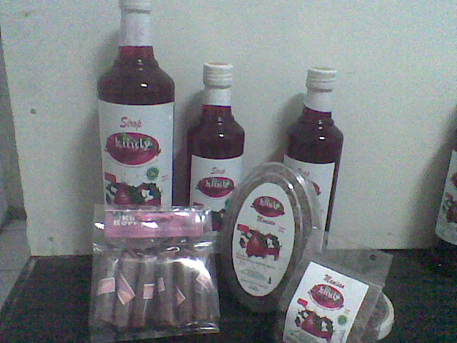

Slide 4
MANISAN STRAWBERRY

Slide 5
DODOL KANTONG

Slide 6
SIROP 620 ml

Slide 7
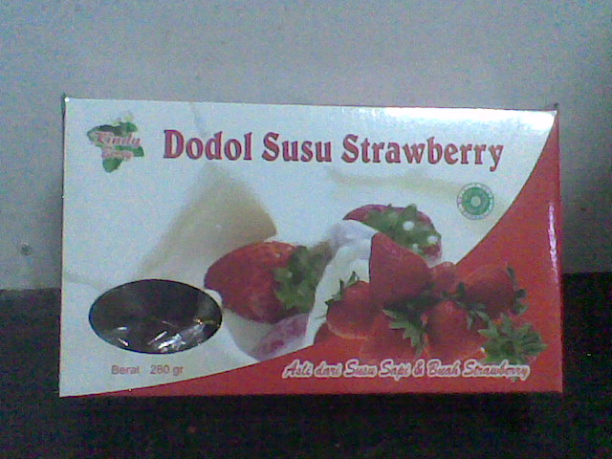
DODOL STRAWBERRY BY KINDY BERRY

Slide 8
Sambal Strawberry 450g

Slide 9
SIROP 620 ml

